Slide 1


An Industrial Training Presentation
Prepared By:
Bharat Kumawat
201903103510326
B.Tech 8th Semester – ICT
CGPIT

Slide 2
Outline
Company Profile
Timeline chart
Training Work (Week Wise)
Screenshots of work during training.
Future Work
References

Slide 3
Company Profile – Bigscal Technologies
Vision: Make life easier by the digital transformation of your work.
Mission: To provide the best quality services that Clients enhance their business growth,Investors looking for a long-term return and Employees feel proud.
Achievements:
12+ Years in Operation
500+ Loyal Clients
750+ Successful Projects
No. of Employees: 150+

Slide 4
Company Profile
Technologies:
Website Development
Vue Js Development
DotNetNuke
Mobile App Development
Testing & QA
Software Product Development
Cross Platform Development
Laravel Development
Address: 1st Floor, B - Millenium Point, Lal Darwaja Station Rd, opp. Gabani Kidney Hospital, Surat, Gujarat 395003
Starting Year: 2011

Slide 5
Timeline Chart:
Company Induction and Learn HTML
Week 1
Completed HTML AND CSS
Week 2
Learn JavaScript
Week 3
Learn TypeScript
Week 4

Slide 6
Training Work

Slide 7
Week-1 Learning
On the first day of the internship we got the brief introduction about the company.
In the first week of the internship, We were given the task to refer the tutorials to revise all essential concepts of HTML. The tutorials covered all the beginner and intermediate concepts of HTML.
At the end of the first week we completed most of the HTML concept.
Company organized the soft skill session for us every week.
In first soft skill session we practiced how to communicate with people. We learned how to start conversation with strangers.

Slide 8
Week-2 Learning
In the second week of the internship, we completed HTML concepts and we started to work with CSS. By the end of this week we completed CSS.
We cleared the main topics like grid, media query, flexbox and almost all concepts which we were assigned.
In this week we went through the bootstrap classes as well as HTML and CSS.
In this week all the trainees were assigned the technology in which they have to work
We are in the ANGULAR technology .

Slide 9
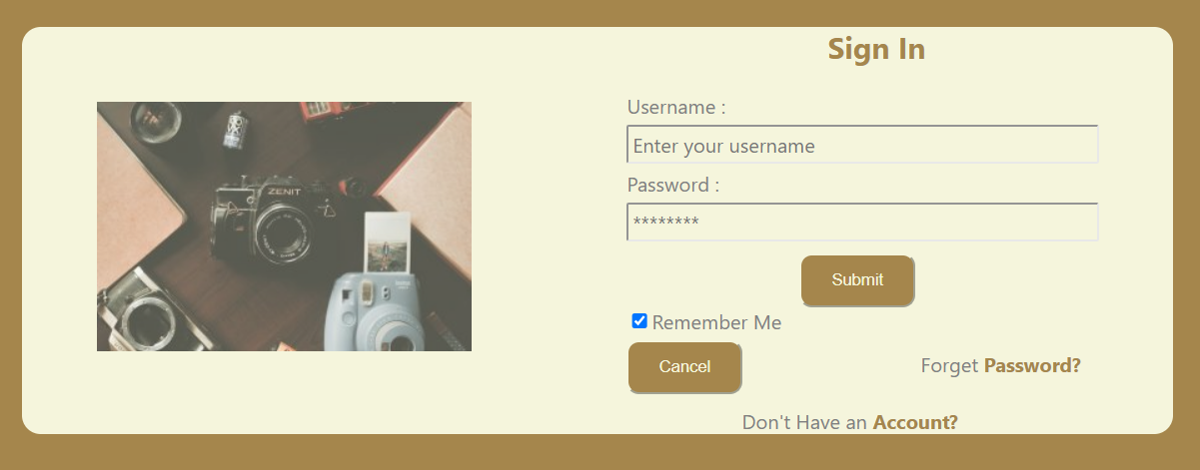
Week-2 Learning
Fig.1-Login page

Slide 10
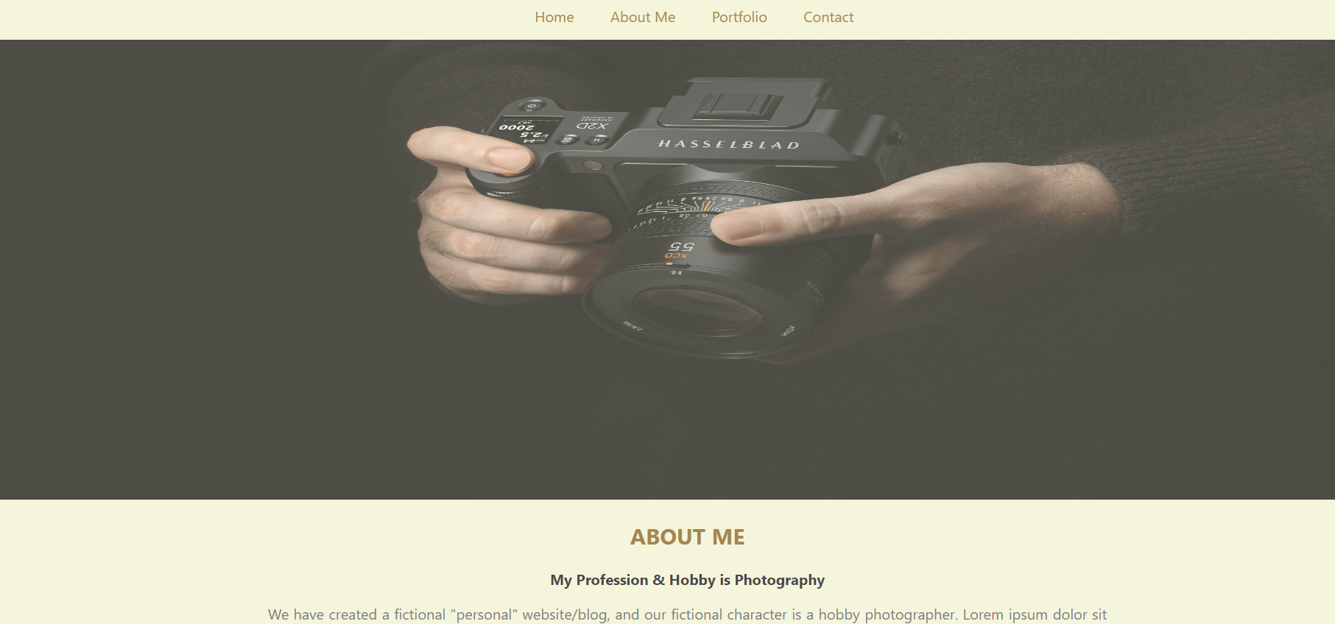
Week-2 Learning
Fig.2-Home page

Slide 11
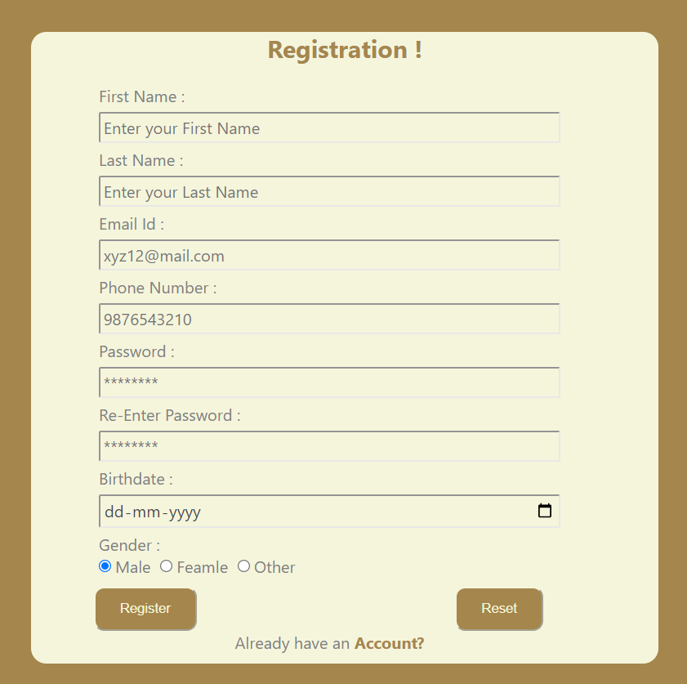
Week-2 Learning
Fig.3-Registration Page Creation

Slide 12
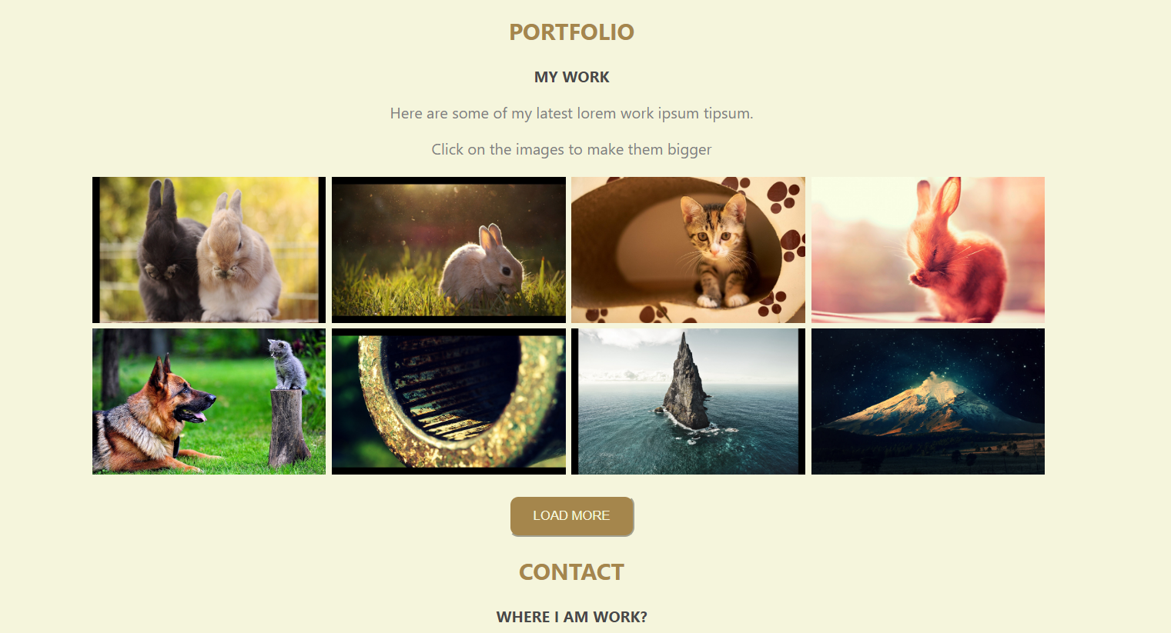
Week-2 Learning
Fig.4-Portfolio Page

Slide 13
Week-3 Learning
In third week we started learning JavaScript concepts.
We completed JavaScript fundamentals in this week. We went through important topics of JavaScript like functions, objects, methods , arrays, data types.
Regular updates were given by us to the mentors.
Some exercises/tasks were assigned to us by the mentors that included concepts of arrays, strings, functions.

Slide 14
Week-4 Learning
In the fourth week we started learning TypeScript concepts.
Currently, We are working on more complex concepts of JavaScript.
We also had our offline soft skill sessions, where we learnt how to build an interview portfolio and how to introduce ourself to the interviewer.
We are still working on JavaScript and TypeScript.
An offline examination was taken which included the concepts of JavaScript.

Slide 15
Future Work
We will complete JavaScript , TypeScript and then we will move to Angular concepts.
And after that we will start working on ANGULAR Projects.

Slide 16
CONCLUSION
https://javascript.info/
https://www.w3schools.com/html/
https://www.w3schools.com/javascript/
https://www.w3schools.com/css/

Slide 17
Thank You

